Slide 1
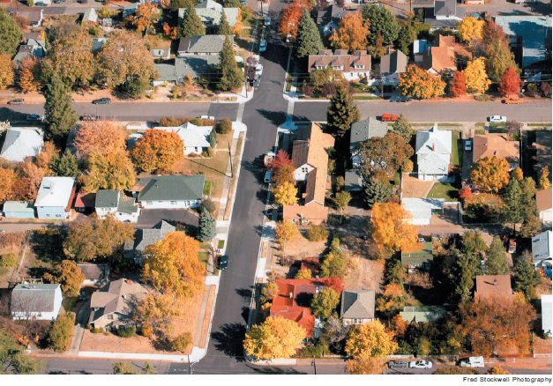
City of Ashland Affordable Housing and Community Development Block Grant Programs
Housing and Human Services Commission October 2021
Linda Reid
Housing Program Specialist

Slide 2
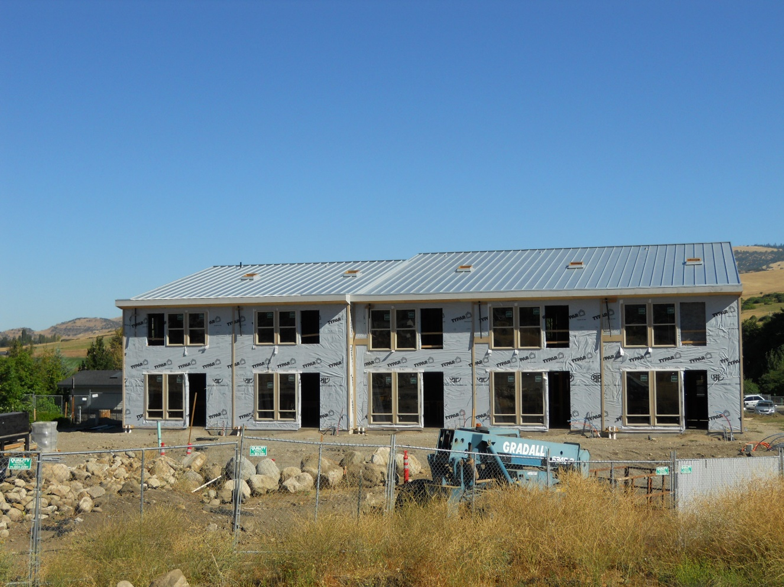
What does the Affordable Housing Program Do?
Housing Program Specialist
CDBG Program
Affordable Housing Program
Social Service Grant Program
Housing and Human Services Commission
Grants & Community Collaboration
Fee Waivers and Regulatory Tools
Community Engagement, Assessment and Strategic Planning
Notes:
The City of Ashland Affordable Housing Program consists of a Housing Program Specialist which oversees two complimentary programs; The City of Ashland Affordable Housing Program and the Community Development Block Grant Program. The two programs work together to remove barriers and provide incentives in an effort to meet the community’s housing needs, which may not otherwise be met by the private market. The City’s Affordable housing program is specific to the development of affordable housing types, while the CDBG program is broader in both context and scope, bringing into consideration multiple factors including community development patterns, social, economic and environmental justice issues, evaluation of barriers to access to housing and the development of various housing types and price points, as well as comprehensive community assessments and planning for allocating federal resources. The assessment and planning processes for both the housing and the CDBG programs include robust opportunities for community engagement and input. The Housing and Human Services Commission plays a key roll in the community engagement process, offering opportunities to provide education and outreach and to garner feedback about community resource needs and agency capacity. Lastly, the Housing Program Specialist and the Housing and Human Services commission oversee the Social Service Grant program. A program that provides over 100K a year in funding to support local organizations in providing needed services to the community. As with the other funding programs, there are sometimes overlap between funding sources and activities.

Slide 3
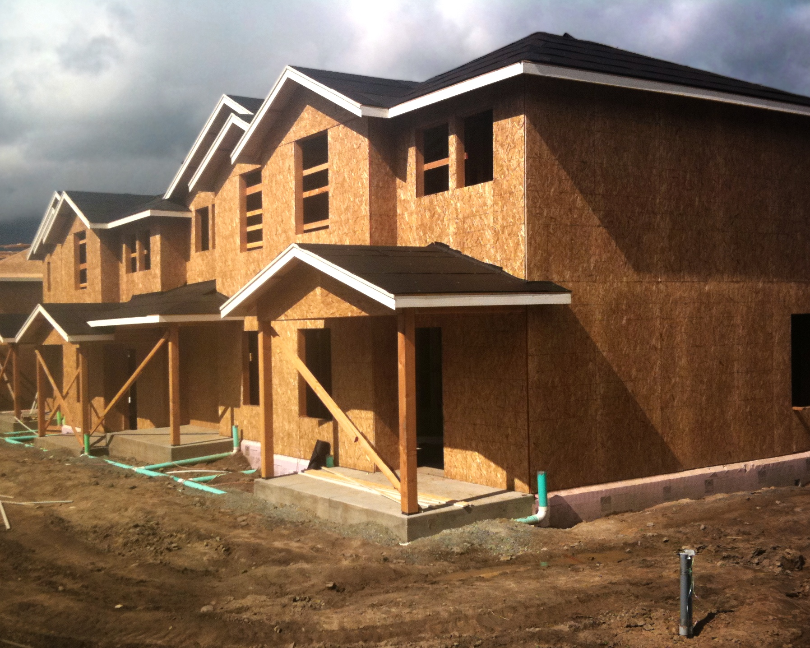
The term “Ashland Housing Program” is applied to various activities the City undertakes to address the unmet housing needs within our community. As there is no single means of adequately addressing the housing issues facing the City, a comprehensive approach toward program development has evolved over time. This comprehensive approach is appropriate to ensure we can implement all tools available to increase the supply of affordable housing.
Affordable Housing Program
Overview
Notes:
Purpose: The City of Ashland’s affordable housing program is a unique and nuanced program which has evolved over time. The Housing Program consists of both Land Use regulations and financial incentives through direct grants and fee waivers.

Slide 4
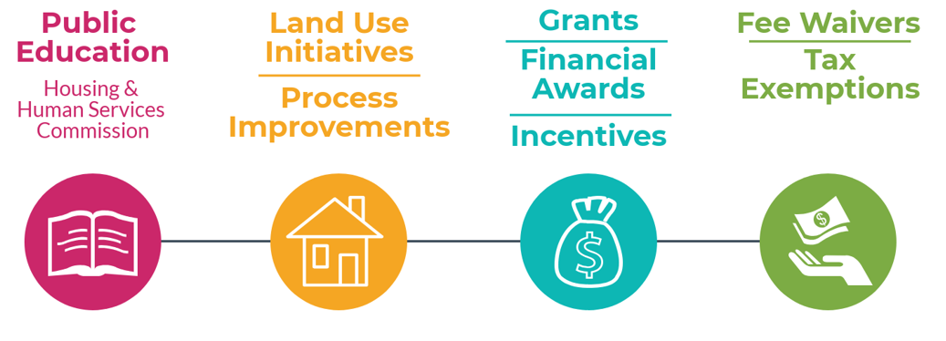
Education Materials
Fair Housing Trainings
Rental Housing Forum
Cottage Housing
Affordable Housing Density Bonus
Affordable Housing for Annexations and Zone Changes
Community Development Block Grants (CDBG)
Affordable Housing Trust Fund
Social Service Grants
System Development Fee Waiver
Community Development and Engineering Fee Waiver
School Construction Excise Tax Waiver
Notes:
The City employs this comprehensive approach to promote the development and retention of affordable housing and to support agencies that assist community members in obtaining and maintaining housing. This approach includes education and outreach, land development standards, and various financial incentives including grants and fee waivers.

Slide 5
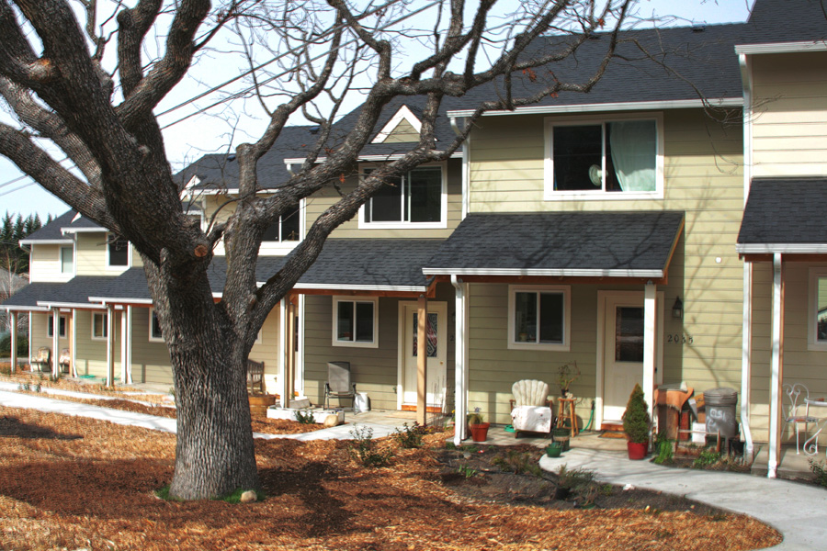
Financial Incentives
Financial Incentives
Financial subsidy:
Community Development Block Grants
Affordable Housing Trust Fund
Land Donation
Reduce Development costs:
System Development Charges waived
Engineering and Community Development Fees waived
School Construction Excise Tax waived
Notes:
Background: The City’s housing program began in the early 90’s with a system development charge deferral program and expanded over time to include a variety financial incentive provisions including:
Community Development Block Grant funding, Affordable Housing Trust Funds,
And in some instances a reduction in land costs or land donation
The City also waives fees such as:
System Development charges
Community Development and Engineering fee waivers
And in some instances the School Construction Excise tax. It is all also worth mentioning, that the City works with the County assessors office to makes sure that the owners of housing units which are deed restricted through the City’s program are only taxed on a value that their home could realize under the City’s program.

Slide 6
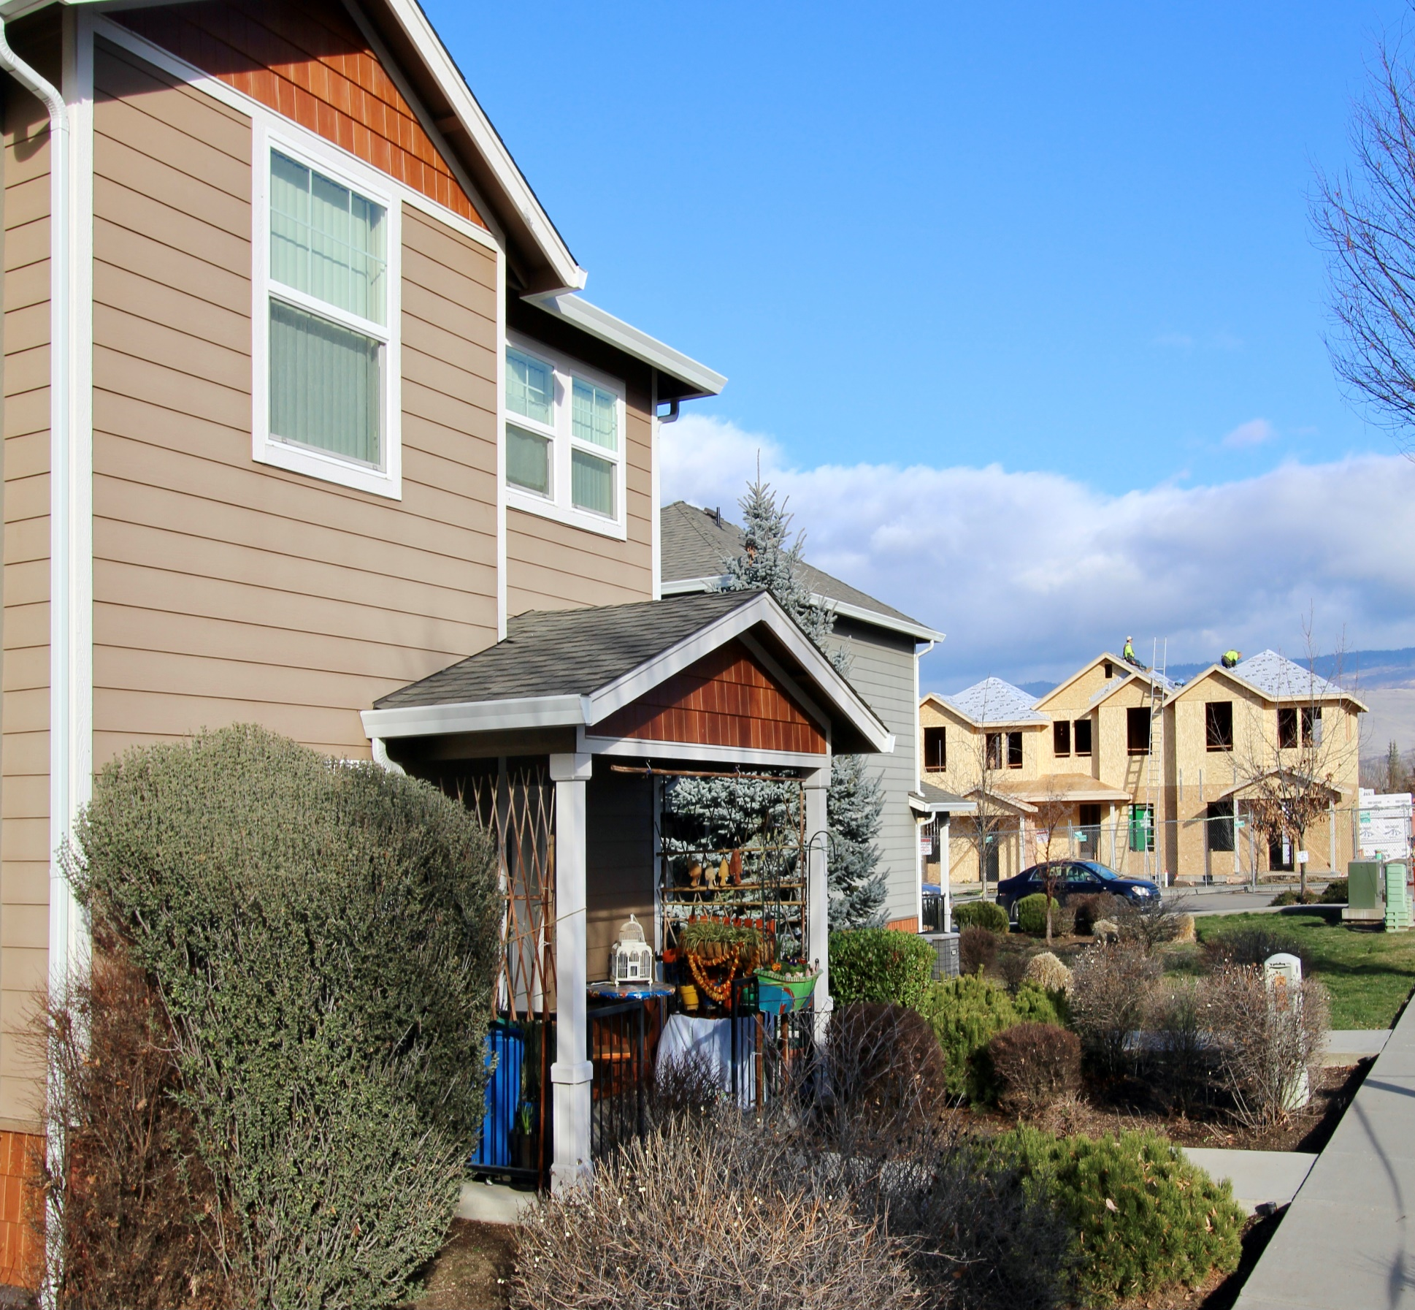
Funding Sources
CDBG
General Fund
Marijuana Tax
Non-Collection of Fees
Affordable Housing Trust Funds
SDC’s
Comm-Dev & Engineering
The City is an Entitlement Jurisdiction for CDBG funding
The City provides System Development Charge Deferrals (non-collection of fees)
The City Waives Community Development and Engineering fees for voluntarily provided affordable housing units
The City Dedicated the first $100,000 Housing Authority of Jackson County’s Tax Revenue toward Snowberry Brook Development I & II.
Notes:
The funding mechanisms primarily impact the general fund, either through the non-collection of fees or through the dedication of funds. The development pictured here, the Snowberry Brook Development I received a variety of incentives from the City and is a prime example of how the regulatory policies, federal grants and general fund subsidies can help to incentivize the development of needed housing types. Snowberry Brook I had required affordable housing units as a condition of approval for the annexation and zone change requests by the original developer. When the original development did not move forward the City worked with the Housing Authority to purchase the land. The City then provided a portion of that land at a reduced cost to the Housing Authority to develop the affordable housing project. HAJC also received a CDBG grant award to install public improvements to access the new housing development, and received a waiver of SDC’s and Comm Dev and engineering fees. Lastly, the City Housing Program Specialist worked with consultants to complete the environmental assessments for both Snowberry Brook I and II which is a requirement of any housing project that receives federal assistance. Another more recent example is the Columbia Care Affordable Housing Development called Rogue Ridge. That development was awarded a $300K Affordable Housing Trust Fund Grant to purchase land in 2018. Again, Housing Program Staff worked with the Department of Housing and Urban Development and consultants to complete the Environmental Assessment process, and lastly, the Rogue Ridge development received System Development Charge deferrals totaling $470K.

Slide 7
Grants Spending for Fiscal Year 2020-2021
Grants
Community Development Block Grant (CDBG)
$175,000 Annual Award
Federal Funding
CDBG-CV: Coronavirus Relief funds
  Pandemic response
  $293,000 in FY21
  Federal Funding
Affordable Housing Trust Fund
$100,000 Annual Funding
Marijuana Tax Revenue
Social Service Grants
  $134,000 Annual Awards
  Transit Occupancy Tax Revenue

Slide 8
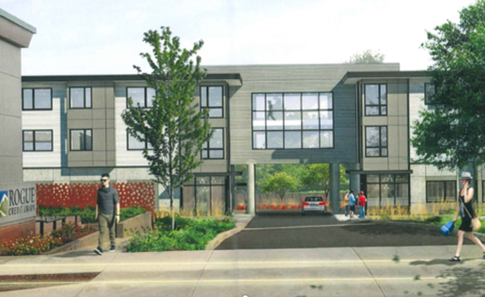
Land Use
Enacted Land Use Policies to incentivize Affordable Housing
Rogue Ridge Development (Columbia Care)
30 New units in 2022
Bonus Density
Condo-Conversion
Annexation
Zone Change
Notes:
The Housing Program also developed Land Use policies that support the goal of developing or maintaining needed housing types such as multi-family and affordable housing. These policies include;
The Condominium-conversion ordinance
The Annexation ordinance,
The Zone change ordinance,
and a Bonus density ordinance.

Slide 9
Land Use Details
Annexation and Zone Changes: 15-33% of new units are affordable. 15% if very low income (60% Area Median Income) to 33% if workforce housing affordable to households earning the median income (up to 120% Area Median Income). Developers can also donate land to an affordable housing provider
Condominium conversions ordinance – intended to retain market rate rentals, or create affordable rental or ownership opportunities.
Density Bonuses: Allows a builder to develop more units if a portion of them are affordable. Works best for affordable housing developers. Incentive based and thus when it costs more to develop a home than it can be rented or sold for, developers do not use the bonus incentive. Was 1 for 1, but in 2014 changed to a 2 for 1 bonus, meaning a builder can build 2 additional market rate units for voluntarily building one affordable dwelling.
Notes:
These mechanisms provide a variety of tools with which to incentivize the provision of housing affordable to a range of incomes not currently met by the market. At present the City’s program covers somewhere around 170 units. Some of the units are rental units, these tend to be owned and managed by affordable housing providers, the majority of the units that the City oversees the transfer of are either owner-occupied units or are rental units which may be offered for sale.

Slide 10
Land Use Incentives (Not Deed Restricted)
Accessory Dwelling Units: Allowed outright in all residential zones in Ashland with issuance of a building permit. There are no parking requirements for ADU’s.
Cottage Housing: Allowed in all single family residential zones.
Duplex Dwelling Units: Allowed outright in all residential zones in Ashland with issuance of a building permit. Duplexes are required to have one parking space per unit.
Minimum Densities: Ensure the limited supply multifamily zoned land is not developed as single family detached homes
Mixed Use Developments: Allow residential uses above commercial ground floors to maximize residential development opportunities
Notes:
In recent years the City has enacted several policies that while not deed restricting units outright are still seen as incentives for encouraging the development of needed housing types, or lower cost housing types.
One example is easing regulations on Accessory Dwelling Units. This policy has served to encourage the development of ADU’s in Ashland.
Approximately 25% of all new housing units developed in Ashland each year are ADU’s.
In 2020-19 ADU’s were built in Ashland, and this was prior to allowing ADU’s outright in all residential zones.
The Cottage Housing Ordinance was adopted in December of 2018 and the City currently has one 12 unit development under construction, and two other developments with planning approvals.

Slide 11
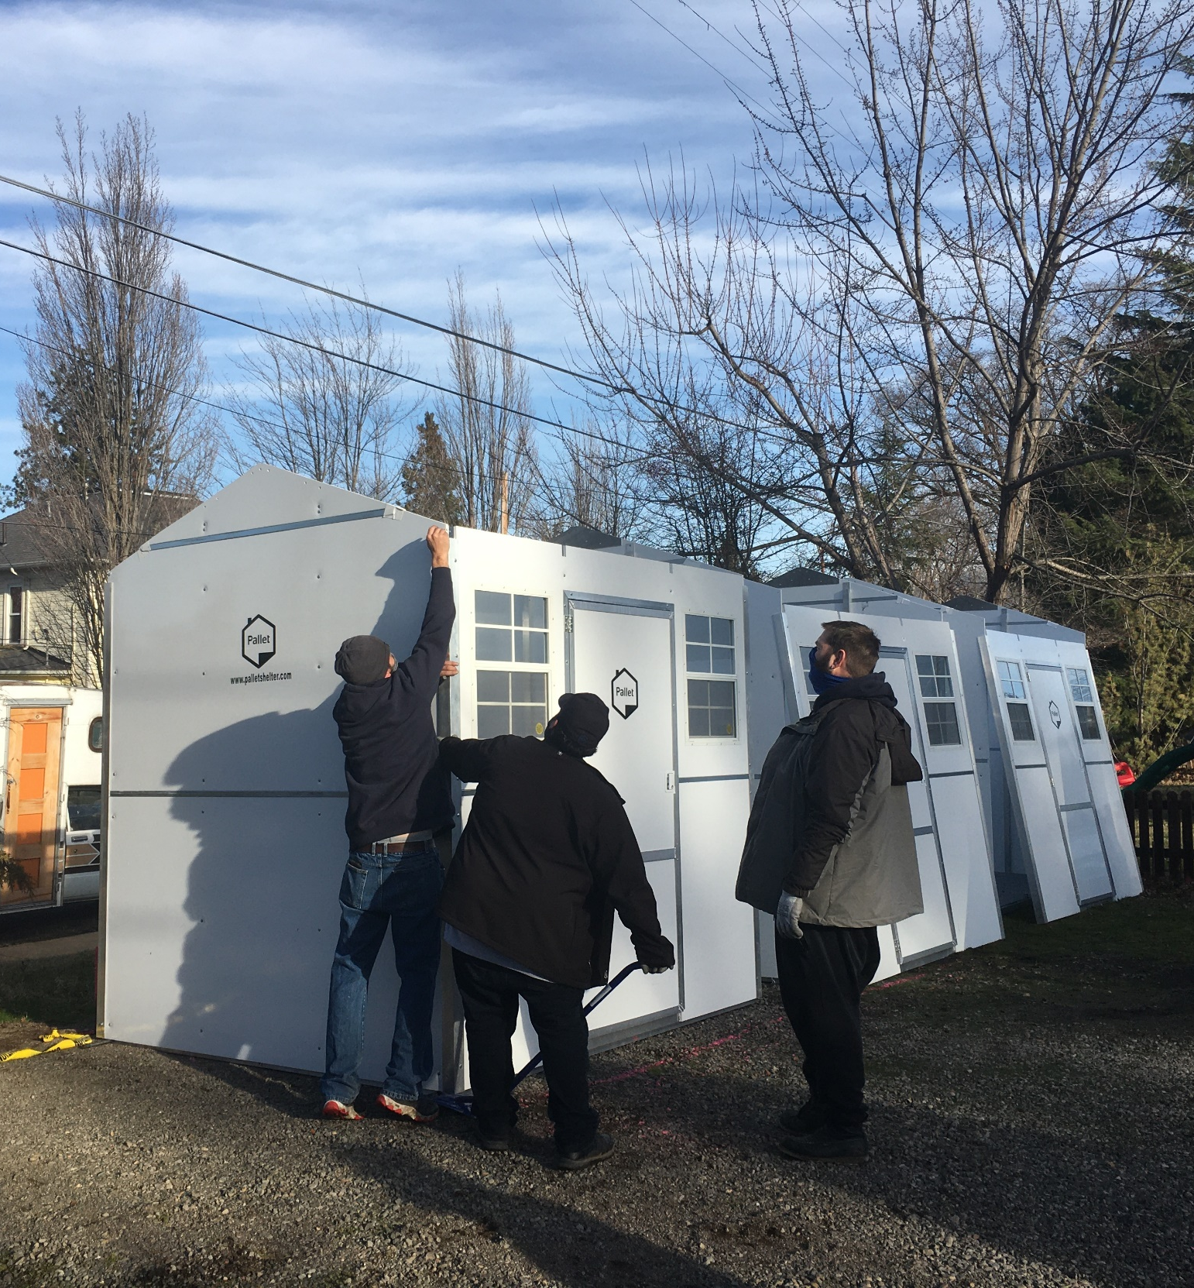
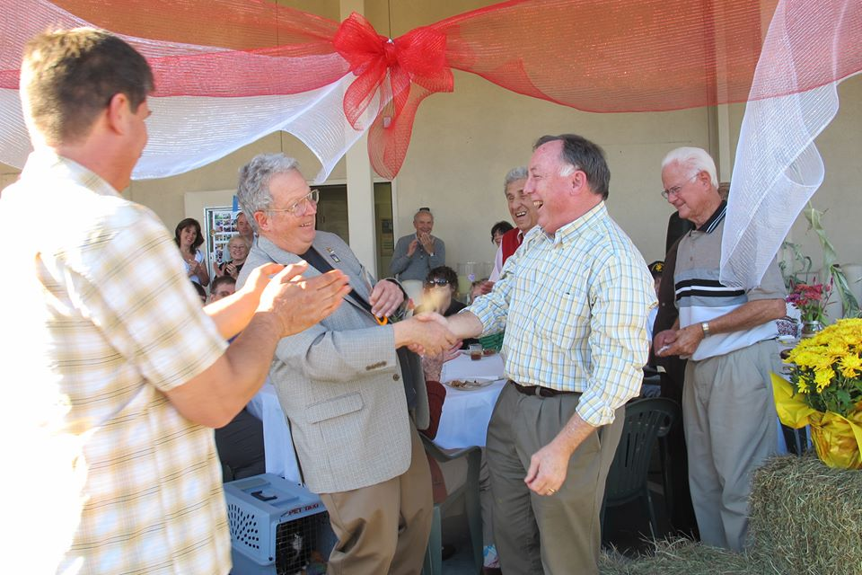
Community Development Block Grant (CDBG) Program Overview

Slide 12
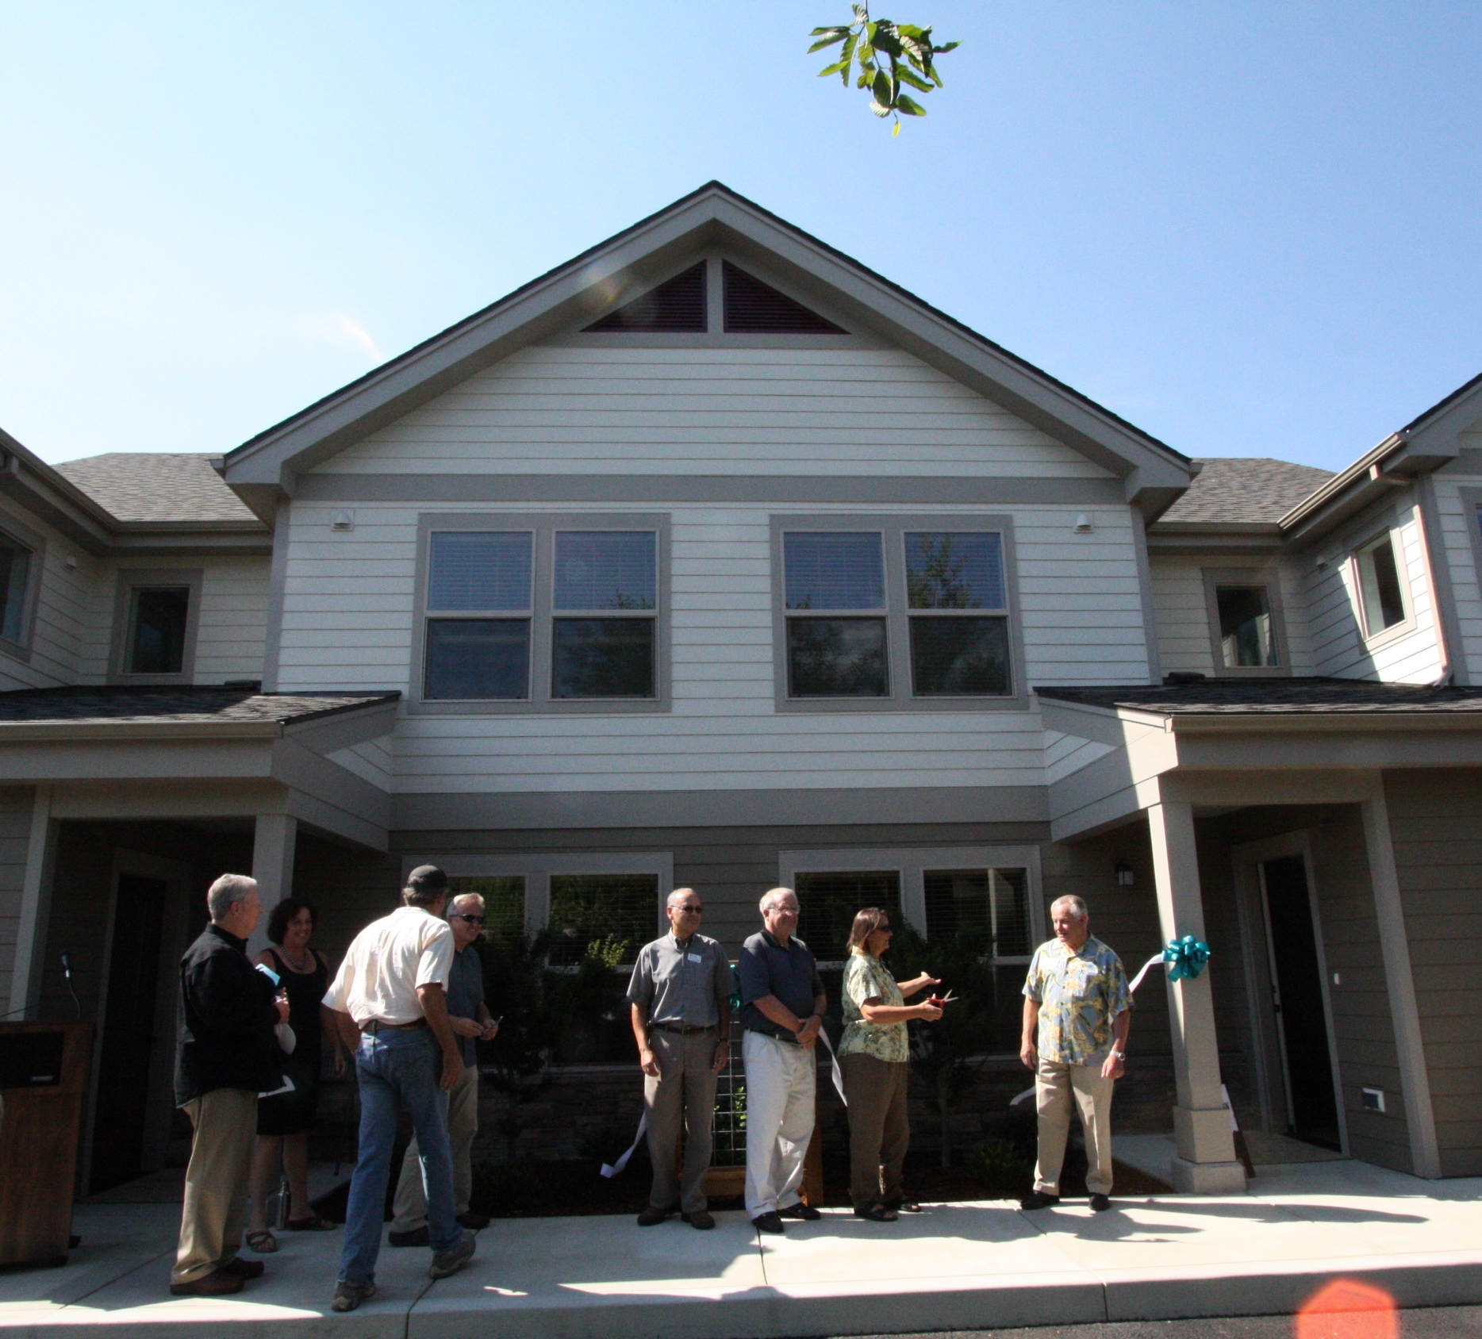
CDBG Program Overview
The City of Ashland receives between $150,000 and $200,000 a year in Community Development Block Grant funds from the U.S. Department of Housing and Urban Development (HUD) for projects benefiting low- and moderate-income residents.
Notes:
The City has been receiving these funds since 1994.

Slide 13
National Objectives
Elimination or Prevention of Slum and Blight
  Area Basis
  Spot Basis
  Urban Renewal
Low to Moderate income benefit
  Area Benefit
  Limited Clientele
  Housing
  Jobs
Meet an Urgent Need
Notes:
All CDBG funded activities must meet one of three national objectives.

Slide 14
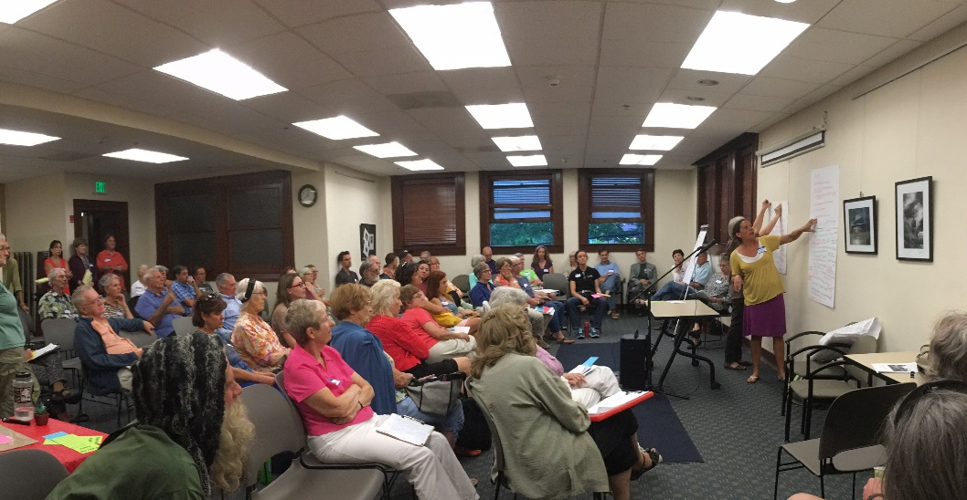
Development of viable urban communities principally for low/moderate income persons through:
Decent Housing
Suitable Living Environment
Expanded Economic Opportunity
Notes:
All CDBG funded activities must meet one of three goals for the CDBG program.

Slide 15
Decent Housing
Assisting Homeless persons obtain affordable housing
Assisting persons at risk of becoming homeless
Retaining affordable housing stock
Increasing the availability of affordable permanent housing in standard condition to low-income and moderate-income families, particularly to minorities
Increasing the supply of supportive housing which includes structural features and services to enable persons with special needs (including persons with HIV/AIDS) to live in dignity and independence
Providing affordable housing that is accessible to job opportunities
Notes:
I’m actually not going to spend a lot of time talking about these next few slides. I am including them because together they outline the types of activities that communities are able to support with Community Development Block Grant funds. They also outline the areas of evaluation that HUD requires grantees to asses within their communities to prioritize the use of federal funds. Generally for the City of Ashland, the provision of affordable housing is our highest priority use of CDBG funding. Over the years the City has supported several activities that fall under the Decent Housing category, including housing rehabilitation for low income homeowners, land acquisition for the development of affordable housing and services to alleviate issues of homelessness.

Slide 16
A SUITABLE LIVING ENVIRONMENT
improving the safety and livability of neighborhoods;
eliminating blighting influences and the deterioration of property and facilities;
increasing access to quality public and private facilities and services;
reducing the isolation of income groups within areas through spatial de-concentration of housing opportunities for lower income persons and the revitalization of deteriorating neighborhoods;
restoring and preserving properties of special historic, architectural, or aesthetic value; and
conserving energy resources and use of renewable energy resources.
Notes:
Over the years the City has also supported several activities that help to create more suitable living environments within the City, including improvements to public facilities such as the purchase of the food bank building, ADA accessibility improvements on public and non-profit owned buildings and in the public right of way, and support for homeless services facilities.

Slide 17
EXPANDED ECONOMIC OPPORTUNITIES
job creation and retention;
establishment, stabilization and expansion of small businesses (including micro-businesses);
the provision of public services concerned with employment;
the provision of jobs to low-income persons living in areas affected by those programs and activities, or jobs resulting from carrying out activities under programs covered by the plan;
availability of mortgage financing for low-income persons at reasonable rates using non-discriminatory lending practices;
access to capital and credit for development activities that promote the long‑term economic and social viability of the community; and
Empowerment and self-sufficiency for low-income persons to reduce generational poverty in federally assisted housing and public housing.
Notes:
The City does not undertake economic opportunity activities very often, and this gets me to the most important aspect of the City’s housing and CDBG programs. And that is that the City neither owns or manages housing units, nor does the City undertake direct service activities with eligible populations. But rather, the City relies on partner agencies and regional coordination to meet the goals and objectives of the Affordable Housing and CDBG programs.

Slide 18

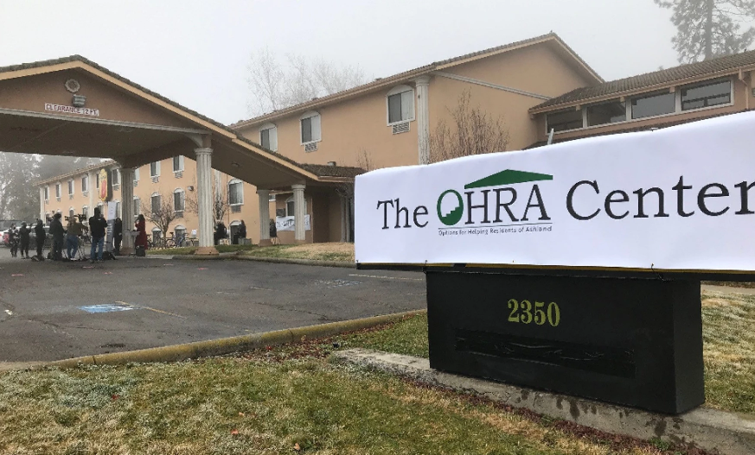

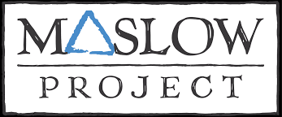

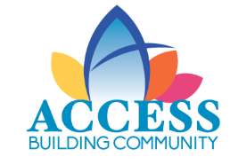



Partnerships and Regional Coordination
Notes:
Obviously, there is more need within the Ashland Community, than can be met with the limited resources the City has to offer and the limited capacity of individual non-profit organizations can provide. To even try to meet the need, it takes regional coordination and inter-agency cooperation to bring together scarce resources and address complex community issues. Regionally, the City coordinates with the Jackson County Continuum of Care and the Jackson County Homeless Task force to coordinate around the regional issues of homelessness. The Jackson County Continuum of Care is a collaboration of governmental and non-profit agencies that is required by HUD in order for regions to access HUD funding for homeless services. This body is also required to undertake the regional Point in Time count survey to assess the number and types of homeless populations and subpopulations, as well as the Housing Inventory Chart, which identifies the number and types of shelter beds a continuum region has to meet the needs identified through the Point in Time Count Process.

Slide 19
Consolidated Planning Process
The City of Ashland’s Consolidated Plan is a five-year strategic plan that provides an outline of action for the community as it works toward meeting the housing and community development needs of its low- and moderate-income households. The plan’s development includes a profile of the community and its economy, an assessment of housing and community development needs, and the development of long-range strategies to meet those needs.
The consolidated plan serves the following functions:
  A planning document for the jurisdiction, which builds on a participatory process among citizens, organizations, businesses, and other stakeholders;
  A submission for federal funds under HUD's formula grant programs for jurisdictions;
  A strategy to be followed in carrying out HUD programs; and
  A management tool for assessing performance and tracking results.
The purpose of the Consolidated Plan is to outline a strategy for the City to follow in using CDBG funding to achieve the goal of the CDBG program, “to develop viable urban communities by providing decent housing and a suitable living environment and expanding economic opportunities principally for low- and moderate-income persons.”
Notes:
The assessment of community needs and the plan for addressing those needs is identified through the Consolidated Planning process. This is essentially the City’s five year grant application to HUD for the continued use of CDBG funding. The plan identifies community needs and specific actions on how the City will target resources to meet those needs. This includes action and outcomes of regional coordination.

Slide 20
CDBG CARES ACT-COVID Activities
CDBG Funding Year | Allocation | Funds Committed COVID-19
2019 | $178,562 | $100,000-OHRA-hotels/meals+$3,808.33 amendment
2020 | $176,899 | $50,000-OHRA-Rental Assistance $52,000-Peace House Meals
CARES ACT (CDBG-CV 1) | $104,079 | $32,000-Peace House Meals $19,968-OHRA Shower Program $20,704.78-Peace House
CARES ACT (CDBG-CV 2) | $189,741 | $41,400.92-OHRA-Winter Shelter
Pre 2019 carryover | $191,631.77 | $6,446.72 –OHRA Shower Program $25,080.00-Pallet Shelter Pilot Project
2021 | $188,801.00 | $270,170-OHRA- Project Turnkey Remodel
Total Funds Committed to COVID Related Activities |  | $621,578.75
Notes:
The City received additional funding to prevent, prepare and respond to issues related to the pandemic. The City worked with partner organizations to address the urgent needs created by the pandemic, especially the needs related to keeping homeless populations safe. The City utilized both CDBG funding, and City general funds, primarily in the form of Affordable Housing Trust funds, to address urgent needs as they arose. The City also coordinated regionally with non-profit agencies and municipalities to address the needs regionally. The City continues to meet regularly with regional partners to coordinate to make the best use of our collective resources while meeting identified needs.

Slide 21
Affordable Housing Trust Funds for COVID Relief
Resource | Total Amount Available | Funds Committed
Affordable Housing Trust Fund | $216,986 | $3,500-OHRA $1,500-JxCo
Grantees
OHRA-Winter Shelter |  | $45,289.86
Maslow Project |  | $60,000
Unitarian Church-Pallet Shelter Pilot Project |  | $5,536.94
Inclement Weather Shelter |  | $1,060.00
Total spent on COVID Related Activities |  | $116,886.80
Notes:
The City also utilized Affordable Housing Trust Funds to address urgent needs related to the pandemic

Slide 22
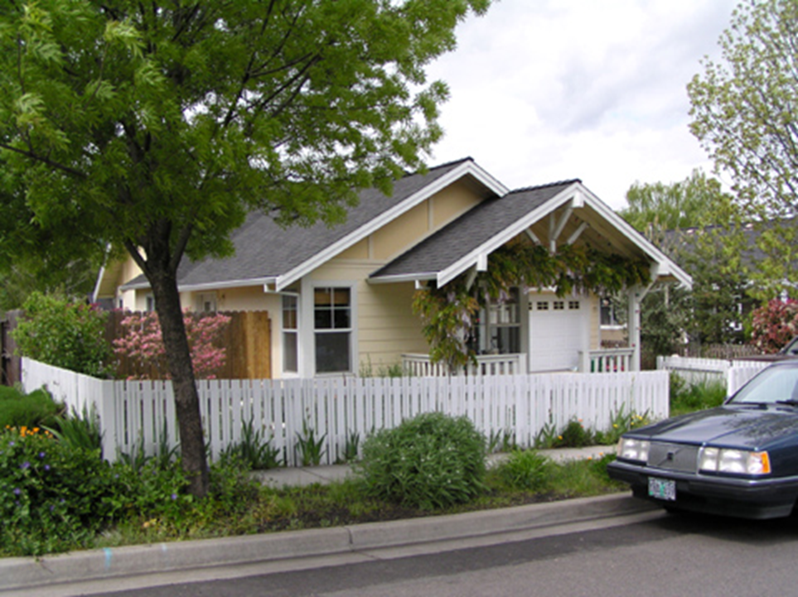
Outcomes
SDC Deferral Program
Financial Incentives
Since 1992 the SDC deferral Program has benefited 133 units targeted to ownership households earning 80% AMI or less and rental households earning 60% AMI or less
Notes:
I’m going to take a moment to talk about some of the Outcomes we have seen as a result of some of the Affordable Housing Program Tools:
To date, SDC deferrals have created the most units in the program, but that is mostly due to inclusion of all the affordable housing units developed within the City being eligible for the deferral as they primarily target lower income households.
The SDC deferral program helps to offset higher land acquisition costs in Ashland versus the land costs in surrounding communities. Helps Ashland continue to be competitive in the Affordable housing development market despite higher land costs.

Slide 23
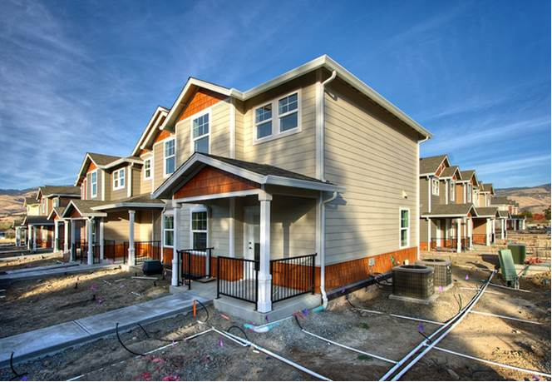
Outcomes
CDBG Program
Financial Incentives
Since 1994 CDBG funds have contributed to the development, rehabilitation and/or acquisition of 95 units of affordable housing targeted to ownership households earning 80% AMI or less and rental households earning 60% and at times 50% AMI or less
Notes:
Much like the System Development Charge Deferral program, the City’s allocation of CDBG funds have been instrumental in the creation of affordable housing. Many units funded with CDBG funds have also received SDC deferrals. So there is quite a bit of crossover in the number of SDC deferral created units and units receiving CDBG funding.

Slide 24
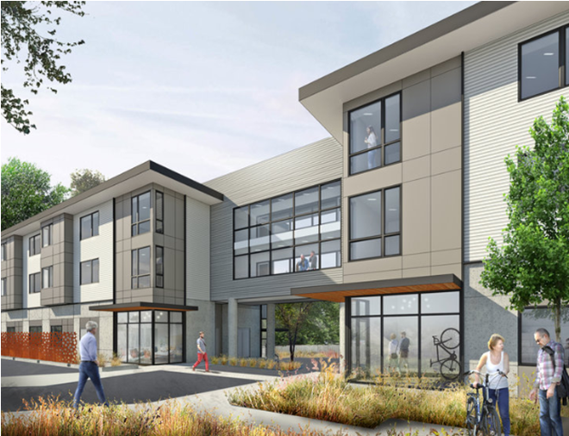
Outcomes
Affordable Housing Trust Funds
Financial Incentives
The City’s Affordable Housing Trust Fund was adopted in 2008, but lacked an ongoing funding source until 2017. The funds were offered through an RFP process for the first time in 2018. The majority of the funding was awarded to Columbia Care for the purchase of land on which to build 30 units of affordable housing. This project will also receive a deferral of System Development Charges and a waiver of Community Development and Engineering fees.
Notes:
2018 was the first time the City offered Affordable Housing Trust funds through a competitive process. The City had 5 applications for projects, three of which were related to the development of affordable housing. The City awarded funding to two projects, one which will provide 30 units of affordable housing in the very near future, and one which funded pre-development costs for a project which included a homeless shelter and/or some permanent supportive housing for homeless populations.

Slide 25
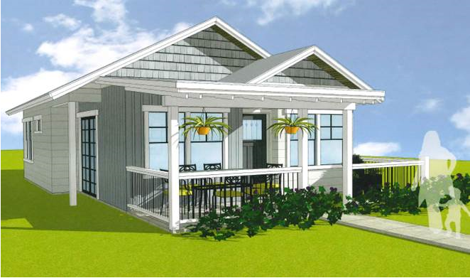
Outcomes
Land Use Policies
Land Use
The City’s Affordable Housing land use policies have encouraged the creation of 106 affordable housing units. These units are primarily targeted to those earning 80% AMI or less, thereby also making them eligible for SDC deferrals. Most of these units were developed by affordable housing providers.
Condo-conversions 16 units-80% AMI
Annexation/Zone Change (Planning Actions) 82 units-60/80%AMI
Bonus Density 8 units-120% AMI
Notes:
There is a lot of overlap between projects which provides affordable housing as a condition of planning approval, because often those planning approvals require a level of affordability that then makes the units eligible to also receive a deferral of SDC’s. Similarly many affordable housing providers qualify for a combination of mechanisms so they might receive several incentives, like utilizing the bonus density, annexing and up zoning land, to maximize the development density, lowering costs with SDC deferrals and utilizing CDBG and Affordable Housing Trust funds for land acquisition and public facilities improvements. These regulations in combination with the provision of financial incentives and direct staff involvement in project development in collaboration with affordable housing providers aid to support the development of affordable housing in a tight housing market.

Slide 26
Thank You!
Questions?

